Slide 1
Virulence factors and their mechanisms of action

Slide 2
INTRODUCTION
The idea that pathogenic microbes are endowed with certain components that confer upon them the capacity for virulence is the central theme of the virulence factor concept.
The virulence factor concept has unquestionably led to the identiﬁcation of important microbial attributes of virulence that have greatly furthered our understanding of microbial pathogenesis.
Furthermore, the approach of deﬁning virulence factors by the use of the molecular postulates has provided an experimentally rigorous approach to the study of virulence in certain microbes.
Nevertheless, the virulence factor concept has signiﬁcant limitations for a global understanding of microbial virulence.

Slide 3
TYPES OF VIRULENCE FACTORS
1-Virulence Factors for Adhesion
first two steps in pathogenesis are exposure and adhesion.
an adhesin is a protein or glycoprotein found on the surface of a pathogen that attaches to receptors on the host cell.
Adhesins are found on bacterial, viral, fungal, and protozoan pathogens.
One example of a bacterial adhesin is type 1 fimbrial adhesin, a molecule found on the tips of fimbriae of enterotoxigenic E. coli (ETEC).
Fimbriae are hairlike protein bristles on the cell surface.
Type 1 fimbrial adhesin allows the fimbriae of ETEC cells to attach to the mannose glycans expressed on intestinal epithelial cells

Slide 4
Table 1. Some Bacterial Adhesins and Their Host Attachment Sites
Pathogen | Disease | Adhesin | Attachment Site
Streptococcus pyogenes | Strep throat | Protein F | Respiratory epithelial cells
Streptococcus mutans | Dental caries | Adhesin P1 | Teeth
Neisseria gonorrhoeae | Gonorrhea | Type IV pili | Urethral epithelial cells
Enterotoxigenic E. coli (ETEC) | Traveler’s diarrhea | Type 1 fimbriae | Intestinal epithelial cells
Vibrio cholerae | Cholera | N-methylphenylalanine pili | Intestinal epithelial cells

Slide 5
2-Bacterial Exoenzymes and Toxins as Virulence Factors
After exposure and adhesion, the next step in pathogenesis is invasion, which can involve enzymes and toxins.
Many pathogens achieve invasion by entering the bloodstream, an effective means of dissemination because blood vessels pass close to every cell in the body.
The downside of this mechanism of dispersal is that the blood also includes numerous elements of the immune system.
Various terms ending in –emia are used to describe the presence of pathogens in the bloodstream.
The presence of bacteria in blood is called bacteremia.
Bacteremia involving pyogens (pus-forming bacteria) is called pyemia.
When viruses are found in the blood, it is called viremia. The term toxemia describes the condition when toxins are found in the blood.
If bacteria are both present and multiplying in the blood, this condition is called septicemia.

Slide 6
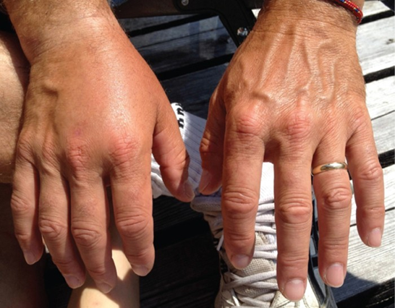
This patient has edema in the tissue of the right hand. Such swelling can occur when bacteria cause the release of pro-inflammatory molecules from immune cells and these molecules cause an increased permeability of blood vessels, allowing fluid to escape the bloodstream and enter tissue.

Slide 7
Patients with septicemia are described as septic, which can lead to shock,
Some bacteria can cause shock through the release of toxins (virulence factors that can cause tissue damage) and lead to low blood pressure.
Gram-negative bacteria are engulfed by immune system phagocytes, which then release tumor necrosis factor, a molecule involved in inflammation and fever.
Tumor necrosis factor binds to blood capillaries to increase their permeability, allowing fluids to pass out of blood vessels and into tissues, causing swelling, or edema.
With high concentrations of tumor necrosis factor, the inflammatory reaction is severe and enough fluid is lost from the circulatory system that blood pressure decreases to dangerously low levels.
This can have dire consequences because the heart, lungs, and kidneys rely on normal blood pressure for proper function; thus, multi-organ failure, shock, and death can occur.

Slide 8
Exoenzymes
Some pathogens produce extracellular enzymes, or exoenzymes, that enable them to invade host cells and deeper tissues.
Exoenzymes have a wide variety of targets. Some general classes of exoenzymes and associated pathogens are listed in Table 2.
Each of these exoenzymes functions in the context of a particular tissue structure to facilitate invasion or support its own growth and defend against the immune system.
For example, hyaluronidase S, an enzyme produced by pathogens like Staphylococcus aureus, Streptococcus pyogenes, and Clostridium perfringens, degrades the glycoside hylauronan (hyaluronic acid), which acts as an intercellular cement between adjacent cells in connective tissue (Figure 2).
This allows the pathogen to pass through the tissue layers at the portal of entry and disseminate elsewhere in the body (Figure 2).

Slide 9
Table 2. Some Classes of Exoenzymes and Their Targets
Class | Example | Function
Glycohydrolases | Hyaluronidase S in Staphylococcus aureus | Degrades hyaluronic acid that cements cells together to promote spreading through tissues
Nucleases | DNAse produced by S. aureus | Degrades DNA released by dying cells (bacteria and host cells) that can trap the bacteria, thus promoting spread
Phospholipases | Phospholipase C of Bacillus anthracis | Degrades phospholipid bilayer of host cells, causing cellular lysis, and degrade membrane of phagosomes to enable escape into the cytoplasm
Proteases | Collagenase in Clostridium perfringens | Degrades collagen in connective tissue to promote spread

Slide 10
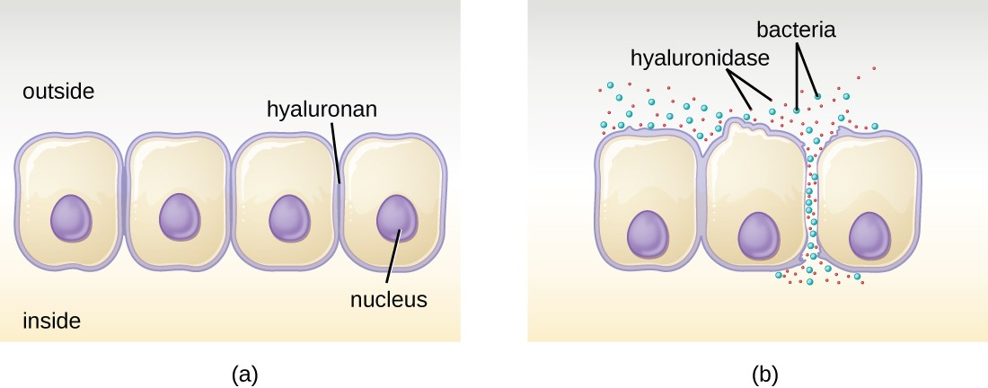
Figure 2. (a) Hyaluronan is a polymer found in the layers of epidermis that connect adjacent cells. (b) Hyaluronidase produced by bacteria degrades this adhesive polymer in the extracellular matrix, allowing passage between cells that would otherwise be blocked.

Slide 11
Pathogen-produced nucleases, such as DNAse produced by S. aureus, degrade extracellular DNA as a means of escape and spreading through tissue.
As bacterial and host cells die at the site of infection, they lyse and release their intracellular contents.
The DNA chromosome is the largest of the intracellular molecules, and masses of extracellular DNA can trap bacteria and prevent their spread.
S. aureus produces a DNAse to degrade the mesh of extracellular DNA so it can escape and spread to adjacent tissues.
This strategy is also used by S. aureus and other pathogens to degrade and escape webs of extracellular DNA produced by immune system phagocytes to trap the bacteria.

Slide 12
Enzymes that degrade the phospholipids of cell membranes are called phospholipases.
Their actions are specific in regard to the type of phospholipids they act upon and where they enzymatically cleave the molecules.
The pathogen responsible for anthrax, B. anthracis, produces phospholipase C. When B. anthracis is ingested by phagocytic cells of the immune system, phospholipase C degrades the membrane of the phagosome before it can fuse with the lysosome, allowing the pathogen to escape into the cytoplasm and multiply.

Slide 13
Bacterial pathogens also produce various protein-digesting enzymes, or proteases.
Proteases can be classified according to their substrate target (e.g., serine proteases target proteins with the amino acid serine) or if they contain metals in their active site (e.g., zinc metalloproteases contain a zinc ion, which is necessary for enzymatic activity).
Collagenase digests collagen, the dominant protein in connective tissue.
The widespread necrosis of tissue and accompanying gas are characteristic of the condition known as gas gangrene (Figure 3).

Slide 14
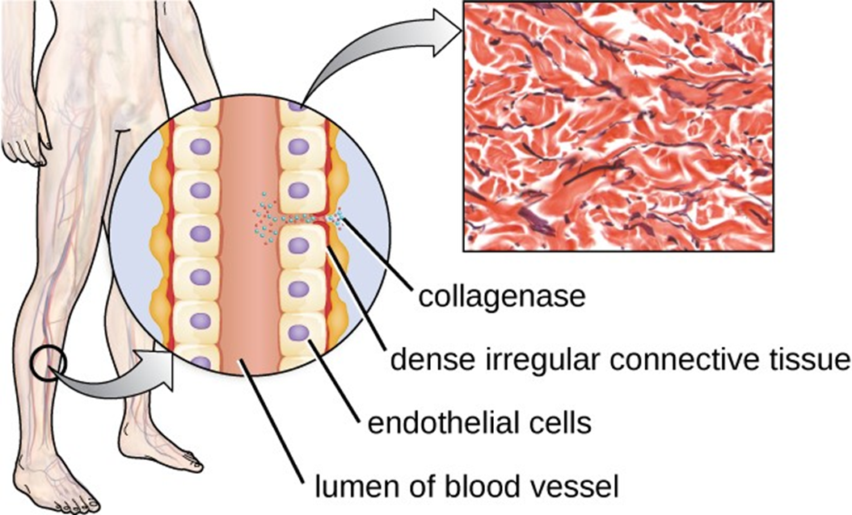
Figure 3. The illustration depicts a blood vessel with a single layer of endothelial cells surrounding the lumen and dense connective tissue (shown in red) surrounding the endothelial cell layer. Collagenase produced by C. perfringens degrades the collagen between the endothelial cells, allowing the bacteria to enter the bloodstream. (credit illustration: modification of work by Bruce Blaus; credit micrograph: Micrograph provided by the Regents of University of Michigan Medical School © 2012)
Two types of cell death are apoptosis and necrosis. Visit this website to learn more about the differences between these mechanisms of cell death and their causes.

Slide 15
3-Toxins
In addition to exoenzymes, certain pathogens are able to produce toxins, biological poisons that assist in their ability to invade and cause damage to tissues. The ability of a pathogen to produce toxins to cause damage to host cells is called toxigenicity.
Toxins can be categorized as endotoxins or exotoxins. The lipopolysaccharide (LPS) found on the outer membrane of gram-negative bacteria is called endotoxin (Figure 4).
During infection and disease, gram-negative bacterial pathogens release endotoxin either when the cell dies, resulting in the disintegration of the membrane, or when the bacterium undergoes binary fission.
The lipid component of endotoxin, lipid A, is responsible for the toxic properties of the LPS molecule.

Slide 16
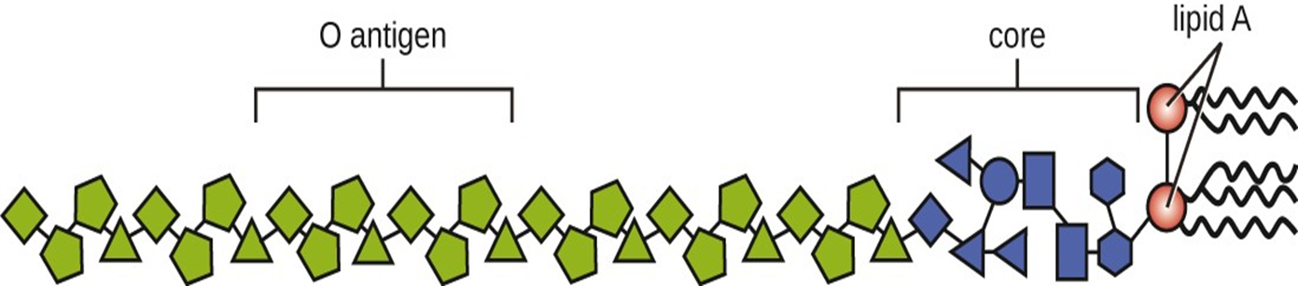
Figure 4. Lipopolysaccharide is composed of lipid A, a core glycolipid, and
an O-specific polysaccharide side chain. Lipid A is the toxic component that
promotes inflammation and fever.

Slide 17
A classic method of detecting endotoxin is by using the Limulus amebocyte lysate (LAL) test. In this procedure, the blood cells (amebocytes) of the horseshoe crab (Limulus polyphemus) is mixed with a patient’s serum. The amebocytes will react to the presence of any endotoxin. This reaction can be observed either chromogenically (color) or by looking for coagulation (clotting reaction) to occur within the serum.
An alternative method that has been used is an enzyme-linked immunosorbent assay (ELISA) that uses antibodies to detect the presence of endotoxin.

Slide 18
EXOTOXINS
Unlike the toxic lipid A of endotoxin, exotoxins are protein molecules that are produced by a wide variety of living pathogenic bacteria. Although some gram-negative pathogens produce exotoxins, the majority are produced by gram-positive pathogens. Exotoxins differ from endotoxin in several other key characteristics, summarized in Table 4.
In contrast to endotoxin, which stimulates a general systemic inflammatory response when released, exotoxins are much more specific in their action and the cells they interact with. Each exotoxin targets specific receptors on specific cells and damages those cells through unique molecular mechanisms. Endotoxin remains stable at high temperatures, and requires heating at 121 °C (250 °F) for 45 minutes to inactivate.

Slide 19
By contrast, most exotoxins are heat labile because of their protein structure, and many are denatured (inactivated) at temperatures above 41 °C (106 °F). As discussed earlier, endotoxin can stimulate a lethal inflammatory response at very high concentrations and has a measured LD₅₀ of 0.24 mg/kg. By contrast, very small concentrations of exotoxins can be lethal. For example, botulinum toxin, which causes botulism, has an LD₅₀ of 0.000001 mg/kg (240,000 times more lethal than endotoxin).

Slide 20
Table 4. Comparison of Endotoxin and Exotoxins Produced by Bacteria
Characteristic | Endotoxin | Exotoxin
Source | Gram-negative bacteria | Gram-positive (primarily) and gram-negative bacteria
Composition | Lipid A component of lipopolysaccharide | Protein
Effect on host | General systemic symptoms of inflammation and fever | Specific damage to cells dependent upon receptor-mediated targeting of cells and specific mechanisms of action
Heat stability | Heat stable | Most are heat labile, but some are heat stable
LD₅₀ | High | Low

Slide 21
The exotoxins can be grouped into three categories based on their target:
1-intracellular targeting,
2-membrane disrupting, and
3-superantigens.
Table 5 provides examples of well-characterized toxins within each of these three categories.

Slide 22
Table 5. Some Common Exotoxins and Associated Bacterial Pathogens
Category | Example | Pathogen | Mechanism and Disease
Intracellular-targeting toxins | Cholera toxin | Vibrio cholerae | Activation of adenylate cyclase in intestinal cells, causing increased levels of cyclic adenosine monophosphate (cAMP) and secretion of fluids and electrolytes out of cell, causing diarrhea
 | Tetanus toxin | Clostridium tetani | Inhibits the release of inhibitory neurotransmitters in the central nervous system, causing spastic paralysis
 | Botulinum toxin | Clostridium botulinum | Inhibits release of the neurotransmitter acetylcholine from neurons, resulting in flaccid paralysis
 | Diphtheria toxin | Corynebacterium diphtheriae | Inhibition of protein synthesis, causing cellular death

Slide 23
Membrane-disrupting toxins | Streptolysin | Streptococcus pyogenes | Proteins that assemble into pores in cell membranes, disrupting their function and killing the cell
 | Pneumolysin | Streptococcus pneumoniae
 | Alpha-toxin | Staphylococcus aureus
 | Alpha-toxin | Clostridium perfringens | Phospholipases that degrade cell membrane phospholipids, disrupting membrane function and killing the cell
 | Phospholipase C | Pseudomonas aeruginosa
 | Beta-toxin | Staphylococcus aureus
Superantigens | Toxic shock syndrome toxin | Staphylococcus aureus | Stimulates excessive activation of immune system cells and release of cytokines (chemical mediators) from immune system cells. Life-threatening fever, inflammation, and shock are the result.
 | Streptococcal mitogenic exotoxin | Streptococcus pyogenes
 | Streptococcal pyrogenic toxins | Streptococcus pyogenes

Slide 24
The intracellular targeting toxins comprise two components: A for activity and B for binding. Thus, these types of toxins are known as A-B exotoxins (Figure 5).
The B component is responsible for the cellular specificity of the toxin and mediates the initial attachment of the toxin to specific cell surface receptors.
Once the A-B toxin binds to the host cell, it is brought into the cell by endocytosis and entrapped in a vacuole.
The A and B subunits separate as the vacuole acidifies. The A subunit then enters the cell cytoplasm and interferes with the specific internal cellular function that it targets.

Slide 25
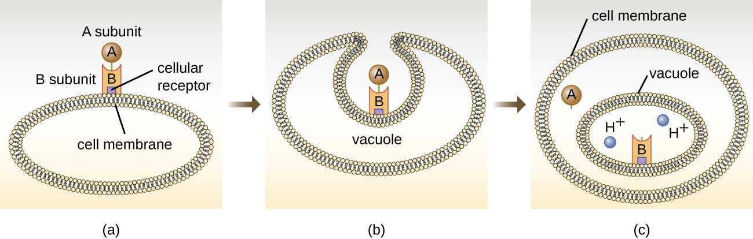
Figure 5. (a) In A-B toxins, the B component binds to the host cell through its interaction with specific cell surface receptors. (b) The toxin is brought in through endocytosis. (c) Once inside the vacuole, the A component (active component) separates from the B component and the A component gains access to the cytoplasm. (credit: modification of work by “Biology Discussion Forum”/YouTube)

Slide 26
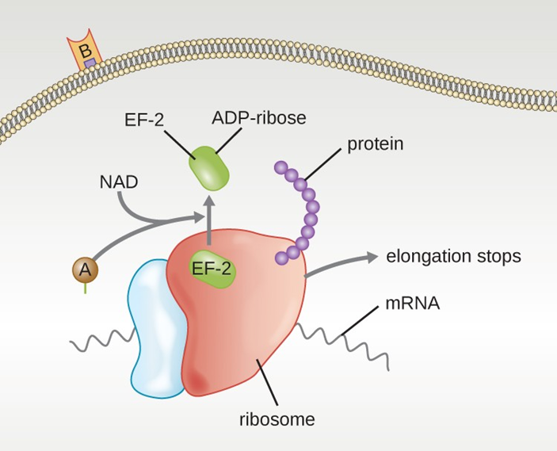
Figure 6. The mechanism of the diphtheria toxin inhibiting protein synthesis. The A subunit inactivates elongation factor 2 by transferring an ADP-ribose. This stops protein elongation, inhibiting protein synthesis and killing the cell.

Slide 27
Four unique examples of A-B toxins are the diphtheria, cholera, botulinum, and tetanus toxins. The diphtheria toxin is produced by the gram-positive bacterium Corynebacterium diphtheriae, the causative agent of nasopharyngeal and cutaneous diphtheria.
After the A subunit of the diphtheria toxin separates and gains access to the cytoplasm, it facilitates the transfer of adenosine diphosphate (ADP)-ribose onto an elongation-factor protein (EF-2) that is needed for protein synthesis. Hence, diphtheria toxin inhibits protein synthesis in the host cell, ultimately killing the cell (Figure 6).

Slide 28
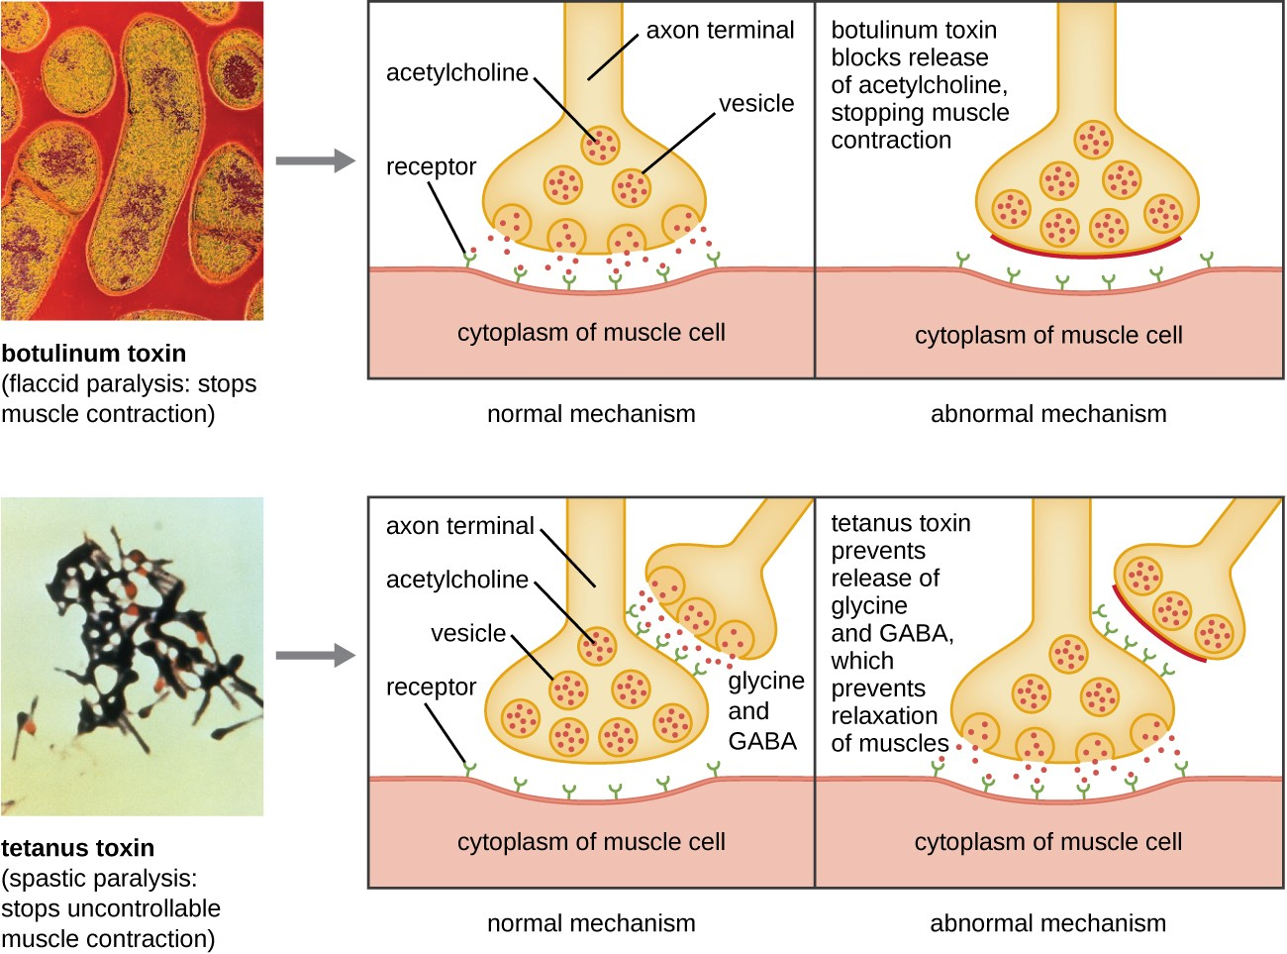
Figure 7. Mechanisms of botulinum and tetanus toxins. (credit micrographs:
modification of work by Centers for Disease Control and Prevention)

Slide 29
Membrane-disrupting toxins affect cell membrane function either by forming pores or by disrupting the phospholipid bilayer in host cell membranes.
Two types of membrane-disrupting exotoxins are hemolysins and leukocidins, which form pores in cell membranes, causing leakage of the cytoplasmic contents and cell lysis.
These toxins were originally thought to target red blood cells (erythrocytes) and white blood cells (leukocytes), respectively, but we now know they can affect other cells as well.

Slide 30
Bacterial phospholipases are membrane-disrupting toxins that degrade the phospholipid bilayer of cell membranes rather than forming pores. We have already discussed the phospholipases associated with B. anthracis, L. pneumophila, and Rickettsia species that enable these bacteria to effect the lysis of phagosomes.
These same phospholipases are also hemolysins. Other phospholipases that function as hemolysins include the alpha toxin of Clostridium perfringens, phospholipase C of P. aeruginosa, and beta toxin of Staphylococcus aureus.

Slide 31
Virulence Factors for Survival in the Host and Immune Evasion
Evading the immune system is also important to invasiveness. Bacteria use a variety of virulence factors to evade phagocytosis by cells of the immune system.
For example, many bacteria produce capsules, which are used in adhesion but also aid in immune evasion by preventing ingestion by phagocytes.
The composition of the capsule prevents immune cells from being able to adhere and then phagocytose the cell. In addition, the capsule makes the bacterial cell much larger, making it harder for immune cells to engulf the pathogen (Figure 8).
A notable capsule-producing bacterium is the gram-positive pathogen Streptococcus pneumoniae, which causes pneumococcal pneumonia, meningitis, septicemia, and other respiratory tract infections.
Encapsulated strains of S. pneumoniae are more virulent than nonencapsulated strains and are more likely to invade the bloodstream and cause septicemia and meningitis.

Slide 32
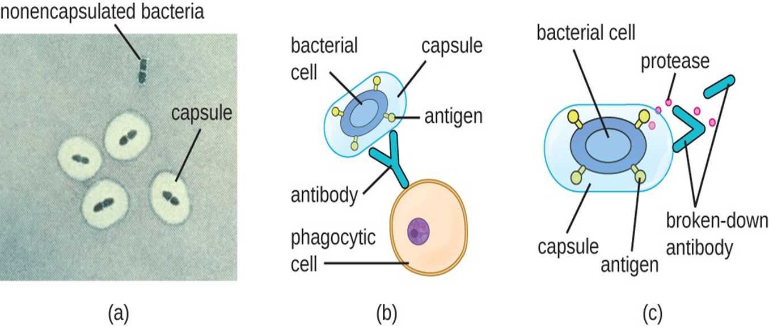
Figure 8. (a) A micrograph of capsules around bacterial cells. (b) Antibodies normally function by binding to antigens, molecules on the surface of pathogenic bacteria. Phagocytes then bind to the antibody, initiating phagocytosis. (c) Some bacteria also produce proteases, virulence factors that break down host antibodies to evade phagocytosis. (credit a: modification of work by Centers for Disease Control and Prevention)

Slide 33
In addition to capsules and proteases, some bacterial pathogens produce other virulence factors that allow them to evade the immune system.
The fimbriae of certain species of Streptococcus contain M protein, which alters the surface of Streptococcus and inhibits phagocytosis by blocking the binding of the complement molecules that assist phagocytes in ingesting bacterial pathogens.
The acid-fast bacterium Mycobacterium tuberculosis (the causative agent of tuberculosis) produces a waxy substance known as mycolic acid in its cell envelope.
When it is engulfed by phagocytes in the lung, the protective mycolic acid coat enables the bacterium to resist some of the killing mechanisms within the phagolysosome.

Slide 34
Some bacteria produce virulence factors that promote infection by exploiting molecules naturally produced by the host.
For example, most strains of Staphylococcus aureus produce the exoenzyme coagulase, which exploits the natural mechanism of blood clotting to evade the immune system.
Normally, blood clotting is triggered in response to blood vessel damage; platelets begin to plug the clot, and a cascade of reactions occurs in which fibrinogen, a soluble protein made by the liver, is cleaved into fibrin.
Fibrin is an insoluble, thread-like protein that binds to blood platelets, cross-links, and contracts to form a mesh of clumped platelets and red blood cells.
The resulting clot prevents further loss of blood from the damaged blood vessels. However, if bacteria release coagulase into the bloodstream, the fibrinogen-to-fibrin cascade is triggered in the absence of blood vessel damage.
The resulting clot coats the bacteria in fibrin, protecting the bacteria from exposure to phagocytic immune cells circulating in the bloodstream.

Slide 35
Whereas coagulase causes blood to clot, kinases have the opposite effect by triggering the conversion of plasminogen to plasmin, which is involved in the digestion of fibrin clots.
By digesting a clot, kinases allow pathogens trapped in the clot to escape and spread, similar to the way that collagenase, hyaluronidase, and DNAse facilitate the spread of infection.
Examples of kinases include staphylokinases and streptokinases, produced by Staphylococcus aureus and Streptococcus pyogenes, respectively. It is intriguing that S. aureus can produce both coagulase to promote clotting and staphylokinase to stimulate the digestion of clots.
The action of the coagulase provides an important protective barrier from the immune system, but when nutrient supplies are diminished or other conditions signal a need for the pathogen to escape and spread, the production of staphylokinase can initiate this process.

Slide 36
Viral Virulence
Although viral pathogens are not similar to bacterial pathogens in terms of structure, some of the properties that contribute to their virulence are similar. Viruses use adhesins to facilitate adhesion to host cells, and certain enveloped viruses rely on antigenic variation to avoid the host immune defenses. These virulence factors are discussed in more detail in the following sections.

Slide 37
Viral Adhesins
One of the first steps in any viral infection is adhesion of the virus to specific receptors on the surface of cells. This process is mediated by adhesins that are part of the viral capsid or membrane envelope. The interaction of viral adhesins with specific cell receptors defines the tropism (preferential targeting) of viruses for specific cells, tissues, and organs in the body. The spike protein hemagglutinin found on Influenzavirus is an example of a viral adhesin; it allows the virus to bind to the sialic acid on the membrane of host respiratory and intestinal cells.

Slide 38
Table 6. Some Viral Adhesins and Their Host Attachment Sites
Pathogen | Disease | Adhesin | Attachment Site
Influenzavirus | Influenza | Hemagglutinin | Sialic acid of respiratory and intestinal cells
Herpes simplex virus I or II | Oral herpes, genital herpes | Glycoproteins gB, gC, gD | Heparan sulfate on mucosal surfaces of the mouth and genitals
Human immunodeficiency virus | HIV/AIDS | Glycoprotein gp120 | CD4 and CCR5 or CXCR4 of immune system cells

Slide 39
Antigenic Variation in Viruses
Antigenic variation also occurs in certain types of enveloped viruses, including influenza viruses, which exhibit two forms of antigenic variation: antigenic drift and antigenic shift (Figure 9). Antigenic drift is the result of point mutations causing slight changes in the spike proteins hemagglutinin (H) and neuraminidase (N). On the other hand, antigenic shift is a major change in spike proteins due to gene reassortment. This reassortment for antigenic shift occurs typically when two different influenza viruses infect the same host.

Slide 40
The rate of antigenic variation in influenza viruses is very high, making it difficult for the immune system to recognize the many different strains of Influenza virus. Although the body may develop immunity to one strain through natural exposure or vaccination, antigenic variation results in the continual emergence of new strains that the immune system will not recognize. This is the main reason that vaccines against Influenzavirus must be given annually. Each year’s influenza vaccine provides protection against the most prevalent strains for that year, but new or different strains may be more prevalent the following year.

Slide 41
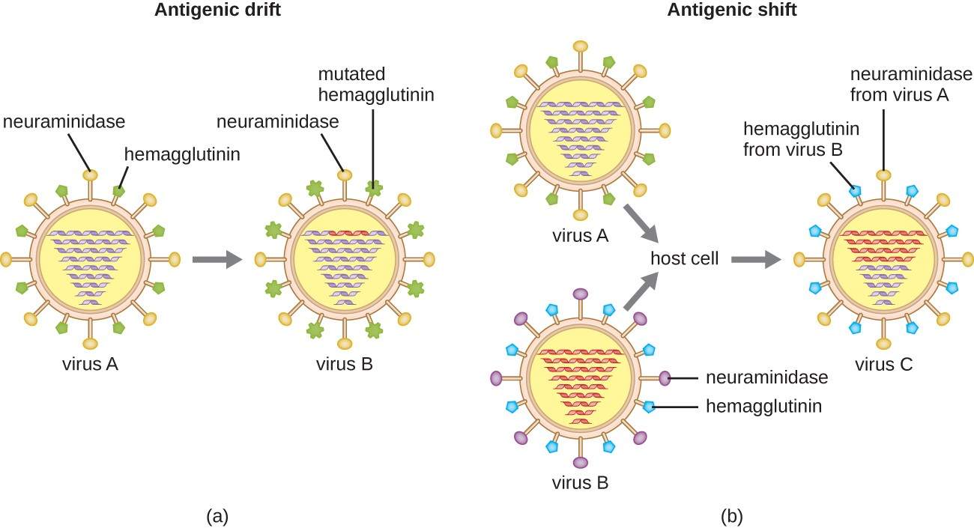
Figure 9. Antigenic drift and antigenic shift in influenza viruses. (a) In antigenic drift, mutations in the genes for the surface proteins neuraminidase and/or hemagglutinin result in small antigenic changes over time. (b) In antigenic shift, simultaneous infection of a cell with two different influenza viruses results in mixing of the genes. The resultant virus possesses a mixture of the proteins of the original viruses. Influenza pandemics can often be traced to antigenic shifts.

Slide 42
KEY CONCEPTS AND SUMMARY
Virulence factors contribute to a pathogen’s ability to cause disease.
Exoenzymes and toxins allow pathogens to invade host tissue and cause tissue damage. Exoenzymes are classified according to the macromolecule they target and exotoxins are classified based on their mechanism of action.
Bacterial toxins include endotoxin and exotoxins. Endotoxin is the lipid A component of the LPS of the gram-negative cell envelope. Exotoxins are proteins secreted mainly by gram-positive bacteria, but also are secreted by gram-negative bacteria.
Bacterial pathogens may evade the host immune response by producing capsules to avoid phagocytosis, surviving the intracellular environment of phagocytes, degrading antibodies, or through antigenic variation.
Viral pathogens use adhesins for initiating infections and antigenic variation to avoid immune defenses.
Influenza viruses use both antigenic drift and antigenic shift to avoid being recognized by the immune system.

Slide 43
Thank You

